Slide 1
AHAMED ALUFAR B A
2021506008
B.Tech Information Technology
Madras Institute of Technology
TNSDC - Machine Learning to
Generative AI
Final Project
DATE:04/04/2024

Slide 2
PROJECT TITLE
Project Title: Fantasy Name Generator: Crafting Characters with Neural Namer
GITHUB LINK:https://github.com/alufar45/PROJECT24

Slide 3


AGENDA
Problem Statement
Project Overview
Objectives
End Users
Solution and Value Proposition
Model Explanation
Results
Conclusion
3/21/2024 Annual Review

Slide 4

PROBLEM STATEMENT
Creating authentic and captivating names for characters in fantasy literature, games, or other creative endeavors is often a daunting task. Writers and creators frequently face the dilemma of crafting names that not only sound fitting for their respective worlds but also possess a distinctiveness that resonates with readers or players. Traditional methods of name generation may lack creativity or fail to capture the unique styles associated with different fantasy authors.
The Neural Namer project addresses this problem by developing a character recurrent neural network (RNN) capable of learning and emulating the naming styles of various fantasy authors. By training the model on datasets containing names from different fantasy franchises, such as Tolkien's Middle-earth or Martin's Westeros, the Neural Namer can generate new names that closely resemble those crafted by these celebrated authors. This tool provides writers, game developers, and enthusiasts with a powerful resource for generating compelling character names that enhance the immersion and authenticity of their fantasy worlds.

Slide 5

PROJECT OVERVIEW
The Fantasy Name Generator: Crafting Characters with Neural Namer project endeavors to develop a versatile tool for generating captivating and authentic fantasy character names inspired by the distinctive styles of renowned fantasy authors. Leveraging the capabilities of recurrent neural networks (RNNs), the project aims to provide a user-friendly interface for generating names that resonate with the essence of various fantasy worlds.

Slide 6
OBJECTIVES
Develop a character RNN capable of emulating the naming styles of multiple fantasy authors.
Collect and curate datasets containing names from prominent fantasy franchises, including works by Tolkien, Martin, Jordan, and others.
Train the neural network model using the collected datasets to learn the distinctive characteristics of each author's naming style.
Implement a user-friendly command-line interface (CLI) for generating fantasy names based on user-specified authors.
Create a web interface for the Neural Namer, allowing users to interactively generate fantasy names in their browser.
Ensure scalability and flexibility of the model to accommodate additional authors or custom datasets in the future.
Provide clear documentation and instructions for setting up the project environment, training the model, and using the generated names in various creative projects.

Slide 7

WHO ARE THE END USERS?
The Fantasy Name Generator: Crafting Characters with Neural Namer project targets writers, game developers, role-playing enthusiasts, world-builders, educators, and creative professionals. It provides a versatile tool powered by recurrent neural networks to generate authentic and immersive fantasy character names inspired by renowned authors like J.R.R. Tolkien and George R.R. Martin. Through a user-friendly command-line interface and interactive web interface, users can effortlessly generate names fitting for their stories, games, tabletop RPGs, and world-building projects. The project aims to streamline the name creation process, enhance immersion in fantasy worlds, and spark creativity in a diverse range of creative endeavors.

Slide 8

YOUR SOLUTION AND ITS VALUE PROPOSITION
Solution:
The Fantasy Name Generator: Crafting Characters with Neural Namer offers a sophisticated solution for generating fantasy character names inspired by the styles of renowned authors. Leveraging recurrent neural networks (RNNs), the Neural Namer model learns the distinct naming conventions of various fantasy authors from curated datasets. Users can interact with the Neural Namer through both a command-line interface (CLI) and an intuitive web interface, enabling them to effortlessly generate authentic and immersive names for their creative projects.
Value Proposition:
Authenticity: The Neural Namer generates names that closely resemble those crafted by celebrated fantasy authors, enhancing the authenticity and immersion of fictional worlds.
Versatility: Writers, game developers, role-playing enthusiasts, and world-builders benefit from a versatile tool capable of generating names for characters, locations, factions, and more.
Efficiency: By automating the name creation process, the Neural Namer streamlines workflow and eliminates the time-consuming task of brainstorming names manually.

Slide 9
THE WOW IN SOLUTION
Authenticity Unmatched: Experience the thrill of generating fantasy names that perfectly capture the essence of legendary authors like Tolkien and Martin, adding an unparalleled level of authenticity to your projects.
Instant Inspiration: Say goodbye to writer's block with the Neural Namer's ability to effortlessly conjure immersive name suggestions, igniting your creativity and propelling your storytelling to new heights.
Versatility Redefined: From character names to place names to faction names, the Neural Namer caters to all your naming needs, ensuring every aspect of your project feels meticulously crafted and immersive.
Seamless Integration: Intuitive interfaces make working with the Neural Namer a breeze, empowering both seasoned developers and novices to effortlessly access its treasure trove of captivating names, ready to breathe life into any creative endeavor.

Slide 10
MODELLING
The Neural Namer employs state-of-the-art recurrent neural networks (RNNs) trained on curated datasets of fantasy author names. Through sophisticated machine learning techniques, the model learns the intricate patterns and nuances of each author's naming style, enabling it to generate new names with remarkable authenticity. By harnessing the power of neural networks, the Neural Namer revolutionizes the process of name creation, offering users a versatile and immersive tool for crafting compelling characters and worlds in the realm of fantasy literature and gaming.

Slide 11
RESULTS
Experience the magic of the Neural Namer as it seamlessly generates captivating fantasy names inspired by your favorite authors. With each click or command, witness the emergence of names that evoke the rich lore and imagination of beloved fantasy worlds. From noble heroes to enigmatic creatures, the Neural Namer delivers an array of authentic name suggestions that elevate your storytelling to new heights. Say farewell to mundane names and embrace the enchanting possibilities unlocked by the Neural Namer, your gateway to endless creativity in the realm of fantasy.

Slide 12
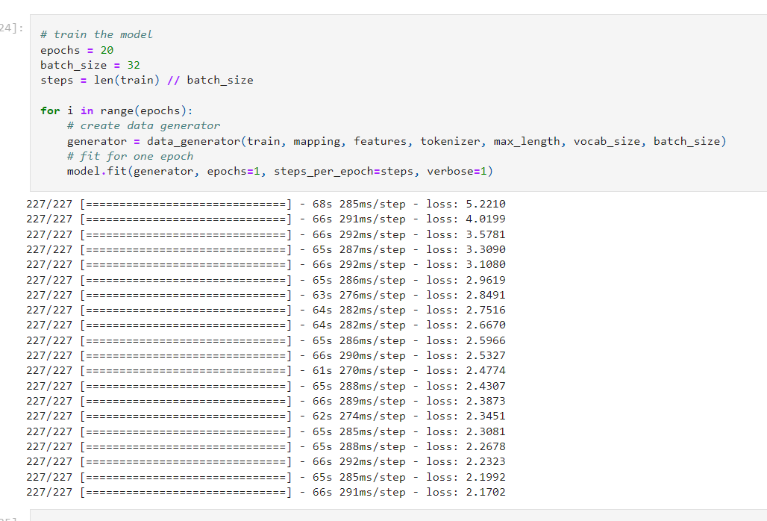
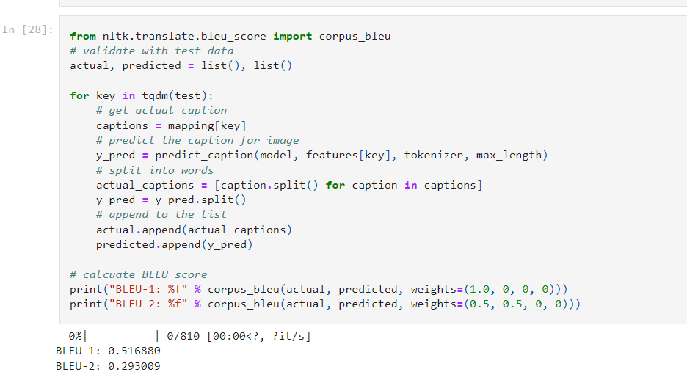
RESULTS

Slide 13
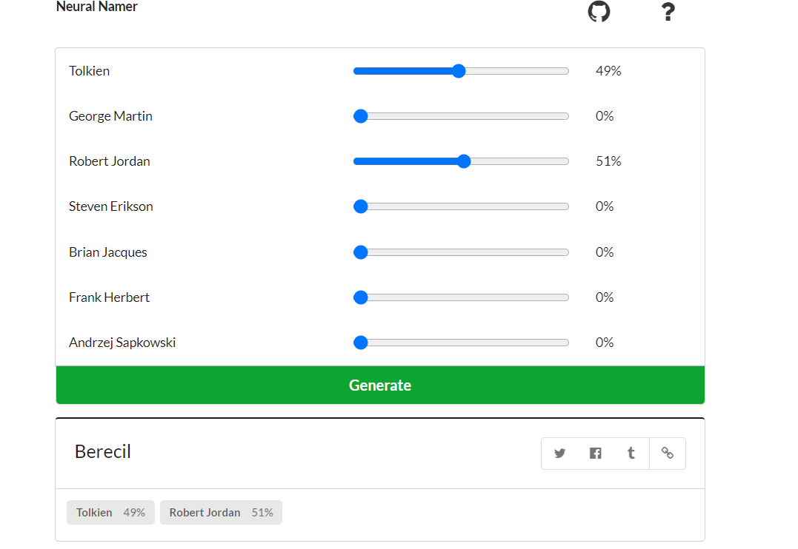
RESULTS

Slide 14
CONCLUSION
The Neural Namer redefines fantasy name generation with its unparalleled authenticity and seamless integration. From inspiring instant creativity to delivering versatile results, it empowers users to craft immersive character names effortlessly, ushering in a new era of storytelling in the realm of fantasy literature and gaming.
GITHUB LINK:https://github.com/alufar45/PROJECT24

